Slide 1
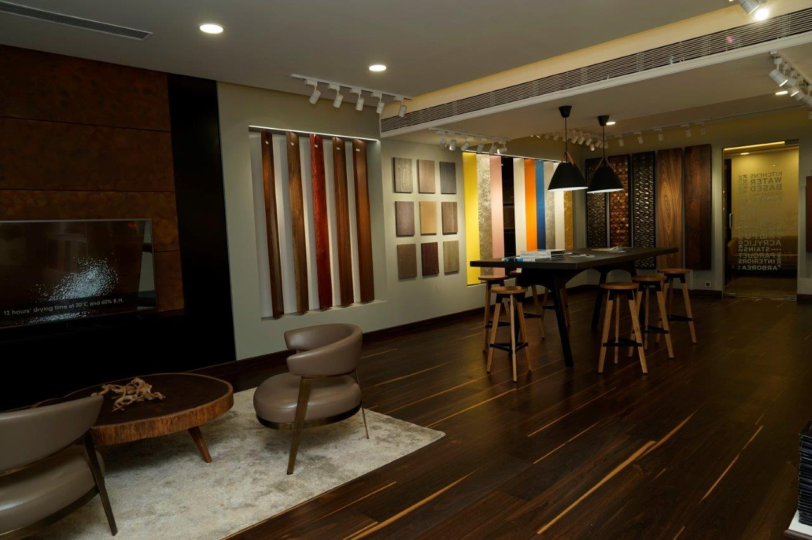
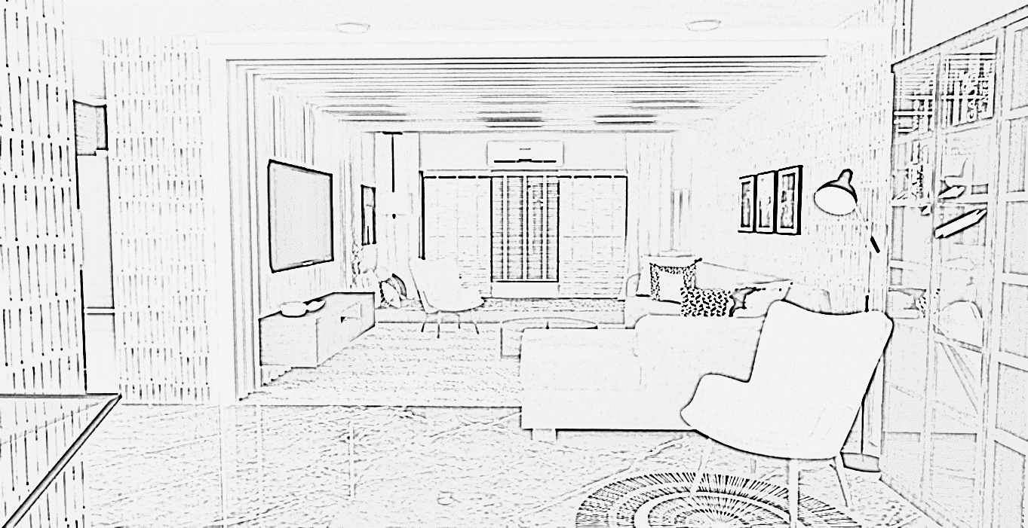
Direction One ELEMENTS
Interiors
Architecture

Slide 2
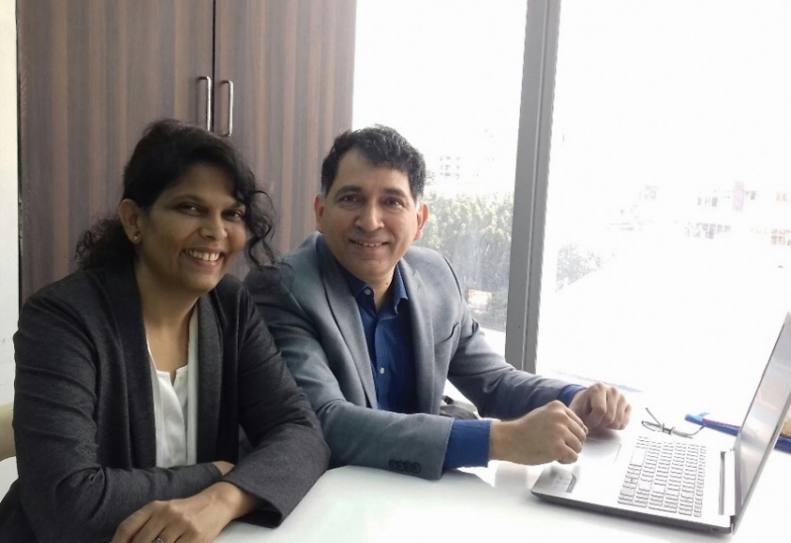
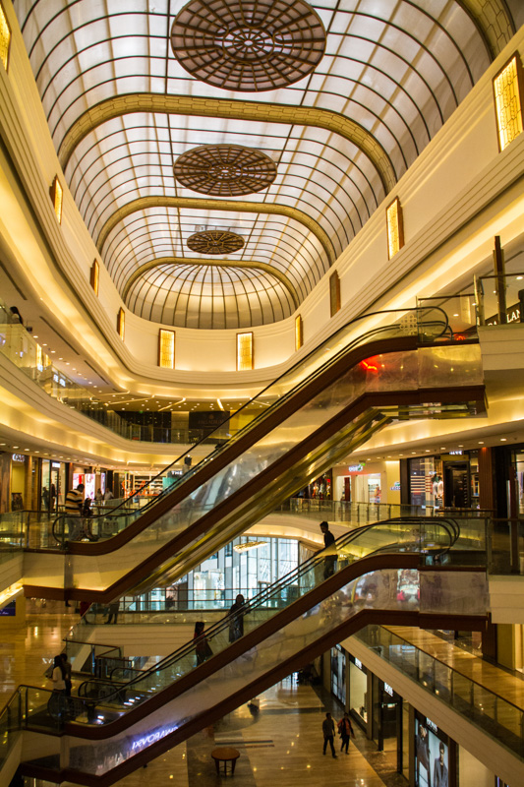
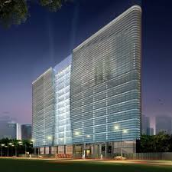
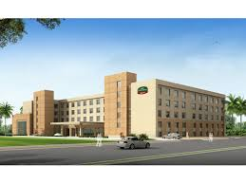
About Direction One elements
Established in May 2015.
Specializing in residential & office interiors and architecture.
Believe in simple elegant economical designs.
Principal Architect - Rupali Inamdar.
Rachana Sansad Academy of Architecture – 1994.
Worked with Iqbal Chaney Pune & Nitin Parulekar Architects on multiple architecture (Courtyard Marriott, Agra Mall) and commercial projects (Motilal Oswal Towers, Worli).
Visiting faculty at various colleges & consultant to architectural firms.
Director – Maneesh Konkar.
PGDM – Indian Institute of Management Bangalore 1995.
Business Growth Consultant & Corporate Trainer - to companies like Cargill, ICICI Bank, Mahindra's, Sanofi, etc.
Faculty at SPJIMR & Great Lakes. Panelist at IIM Bangalore.

Slide 3
Process Control
Process Measures Critical to us –
Quality
Cost Control.
Time.
Execution Excellence
KYC Process.
Design Process.
Communication Process.
Contractor Execution process.
Site Modification Process.
Financial Control.

Slide 4

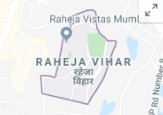







Our Clients
Residence Interiors
Office Interiors

Slide 5
OFFICE INTERIORS

Slide 6
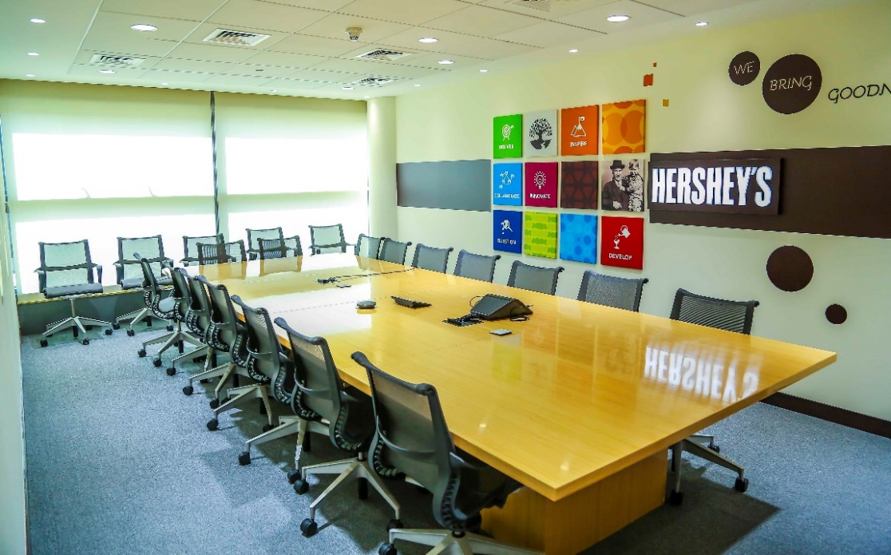



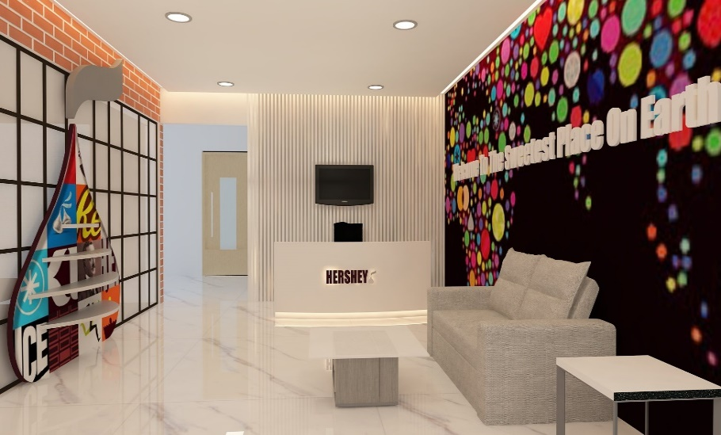
Our Design Concept Inspired by Hersheys “Authentic History” & “Iconic Brands”
HERSHEY – Corporate Head office (7500 sq.ft.)

Slide 7
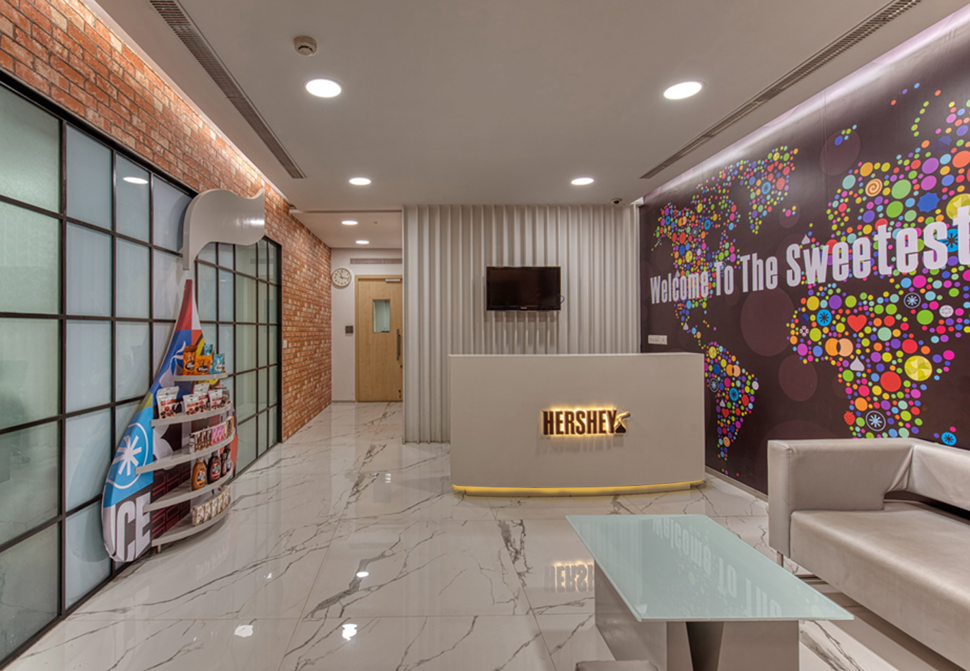
Hershey design Idea – Actual Implementation

Slide 8
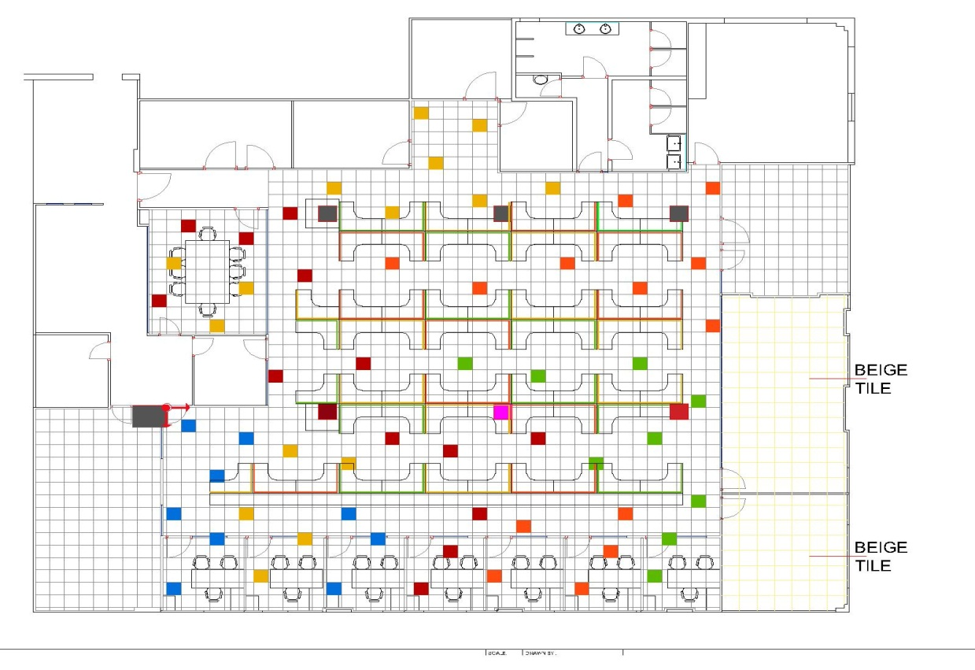
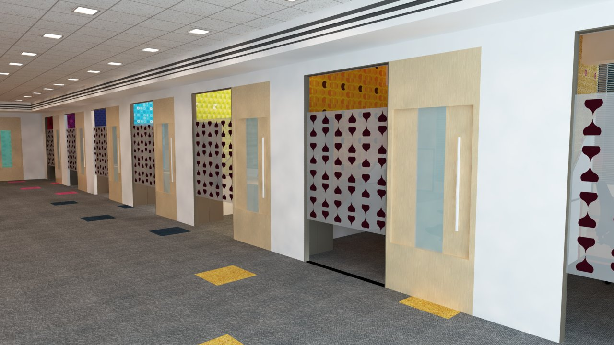
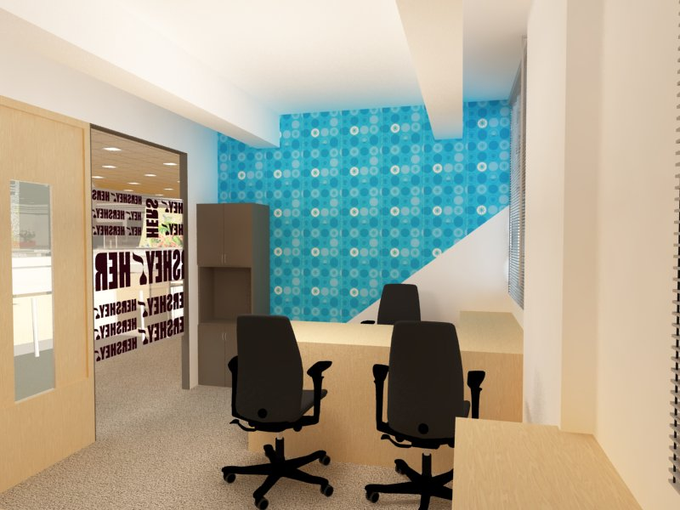
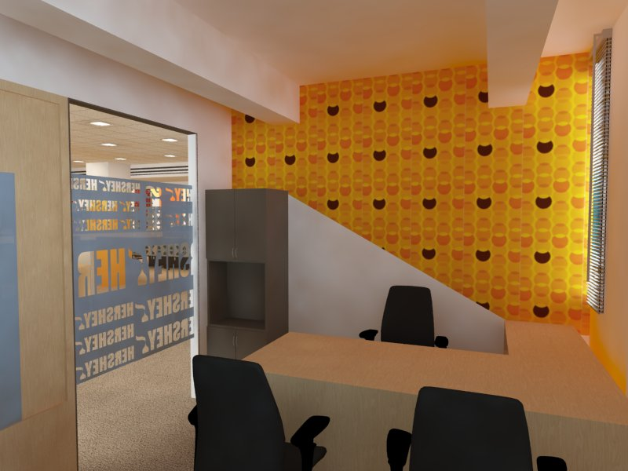
Hershey Design Idea – Cabins

Slide 9
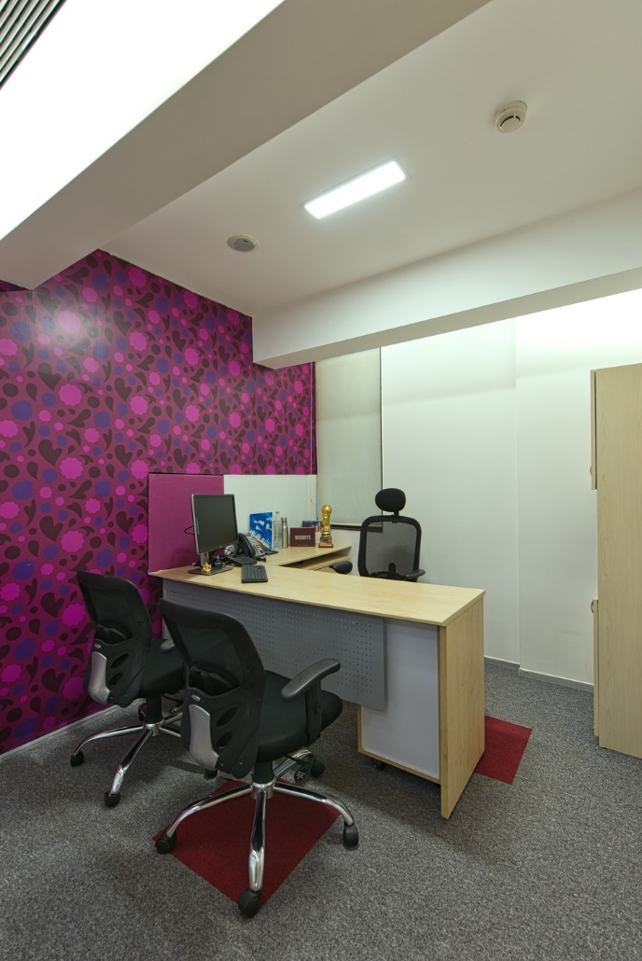
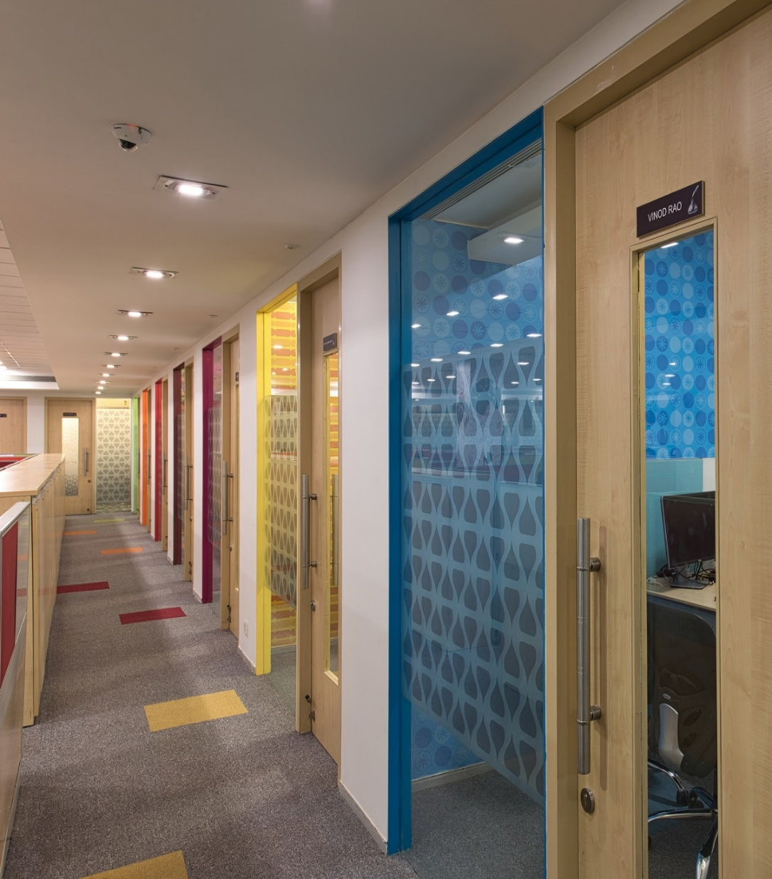
Actual Implementation – Cabins

Slide 10
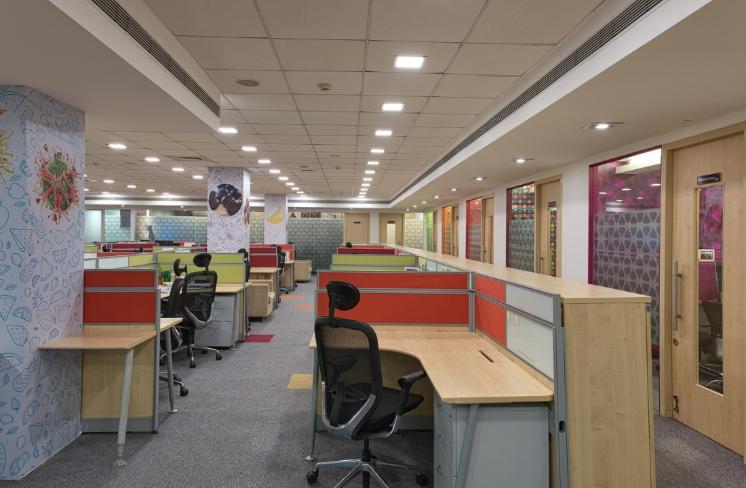
Hersheys -Workstation

Slide 11
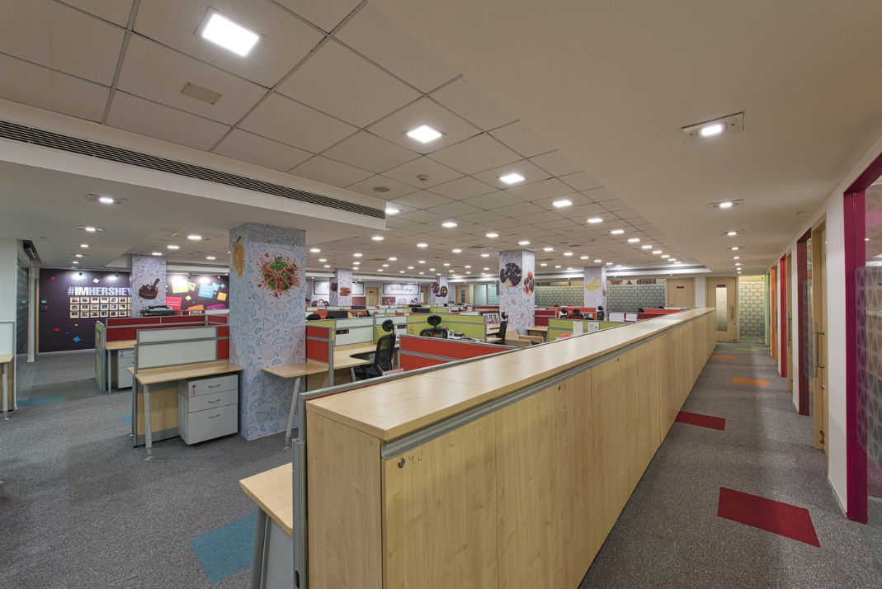
Hersheys -Workstation

Slide 12
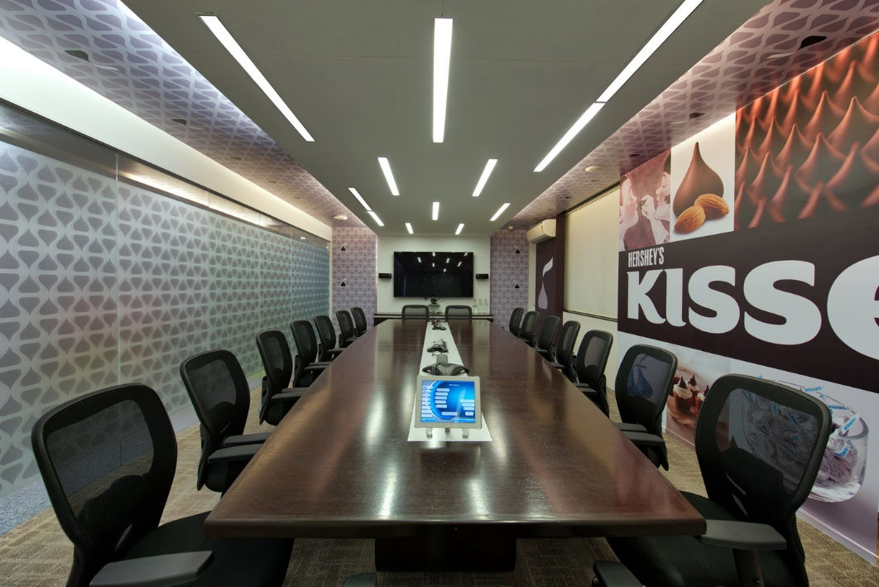
Hersheys – Conference room

Slide 13
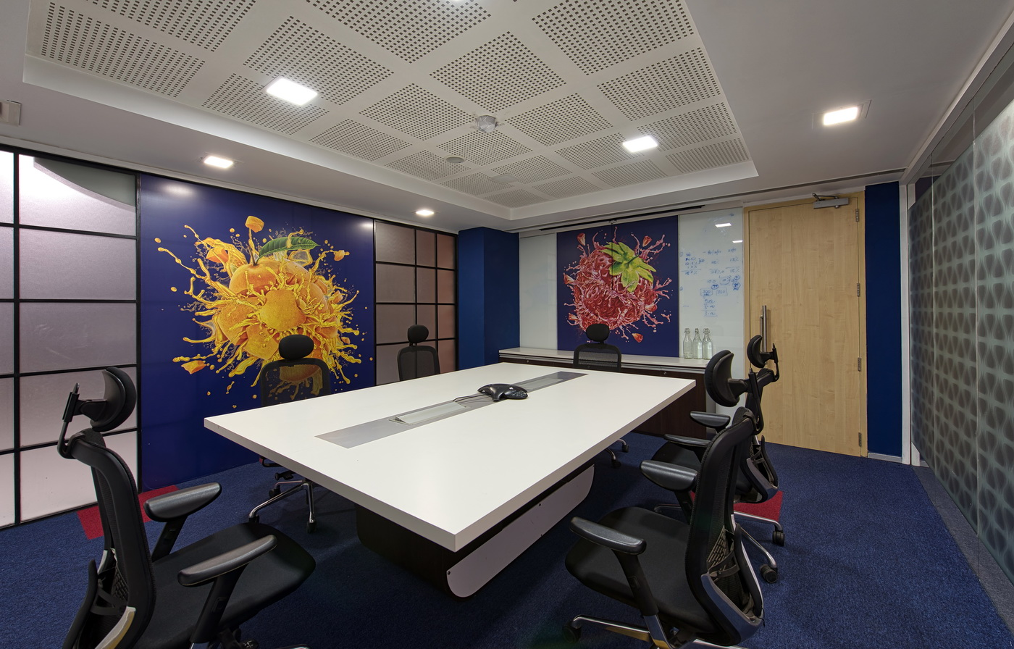
Hersheys – Meeting Room

Slide 14
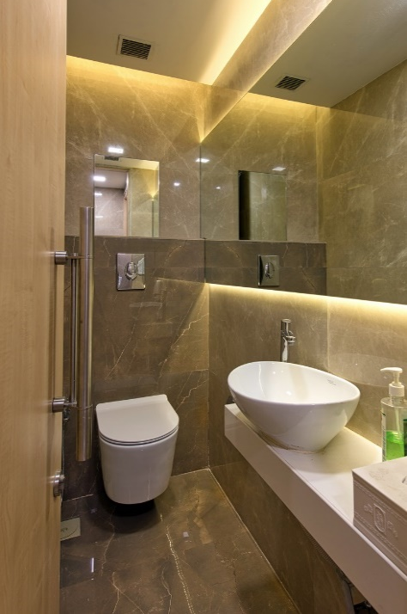
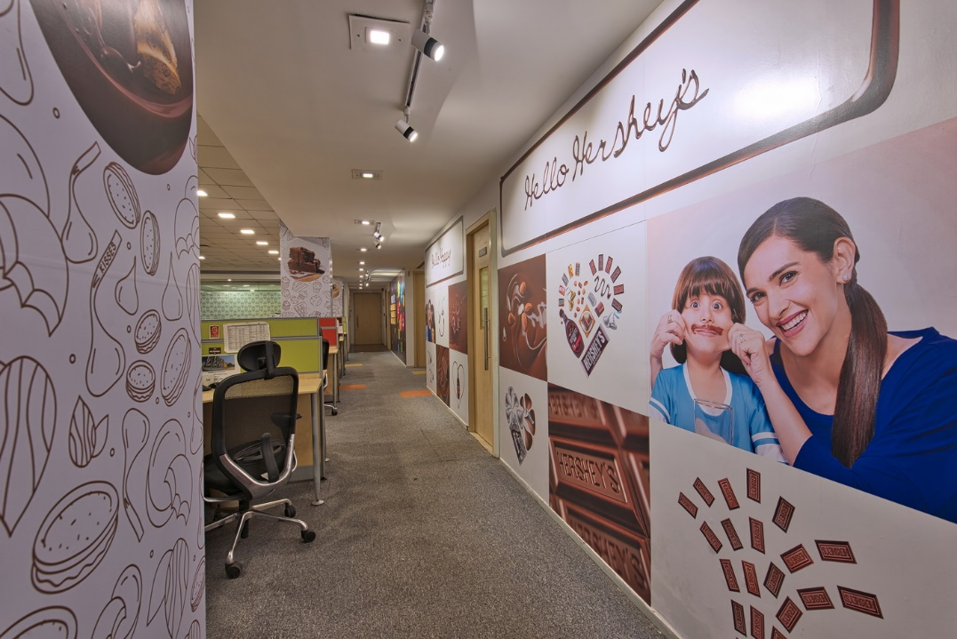
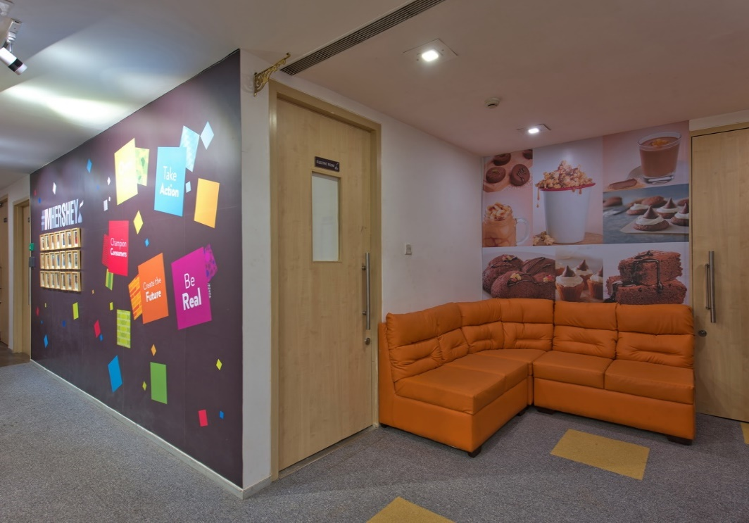
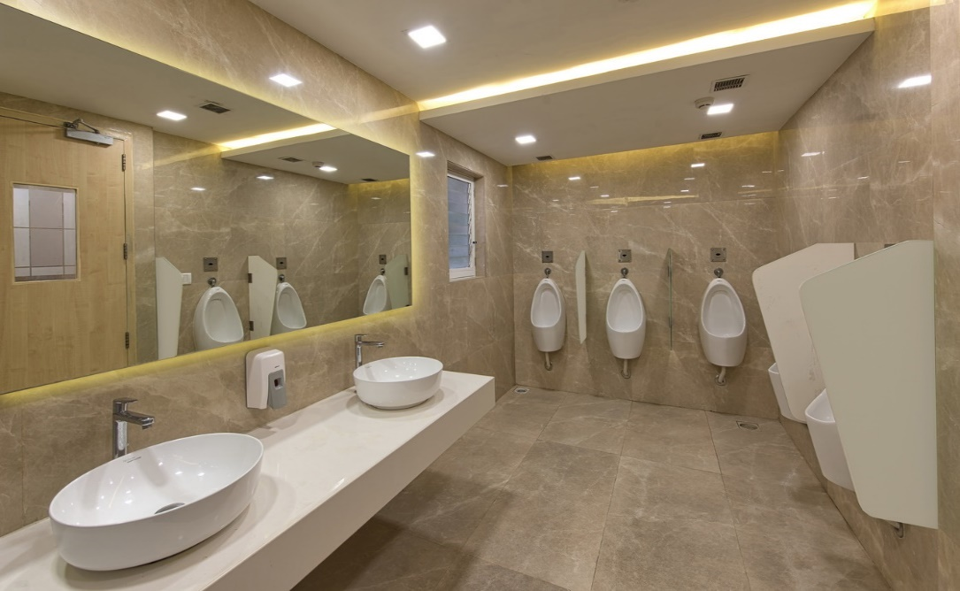
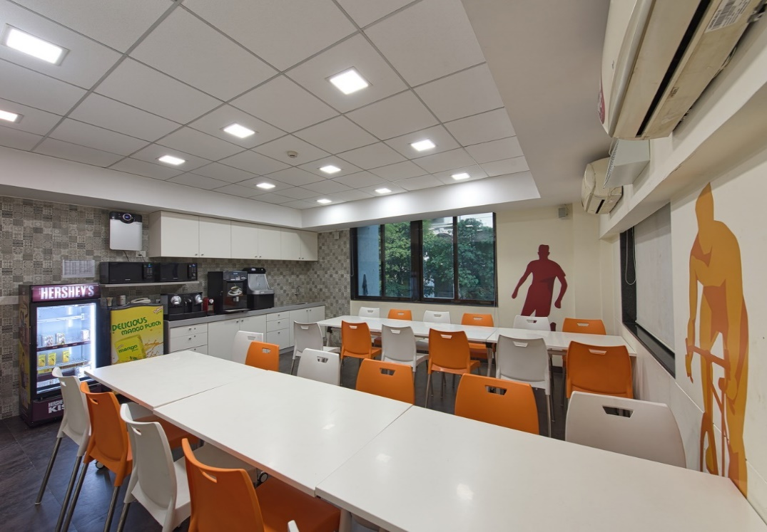
Hersheys – Other Areas

Slide 15
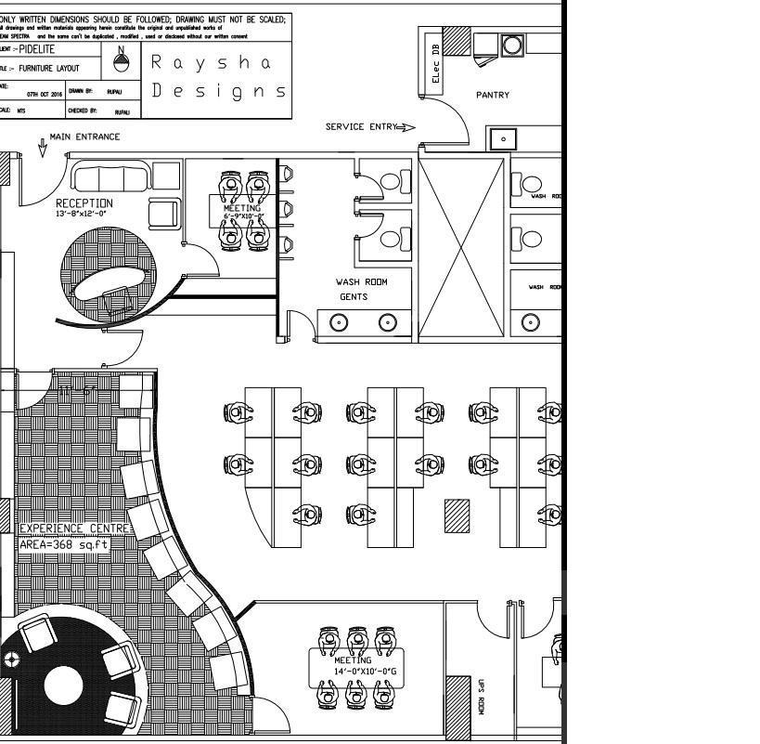
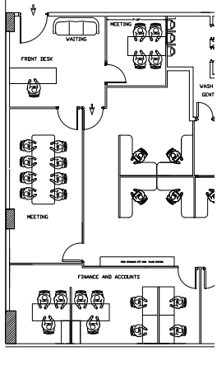
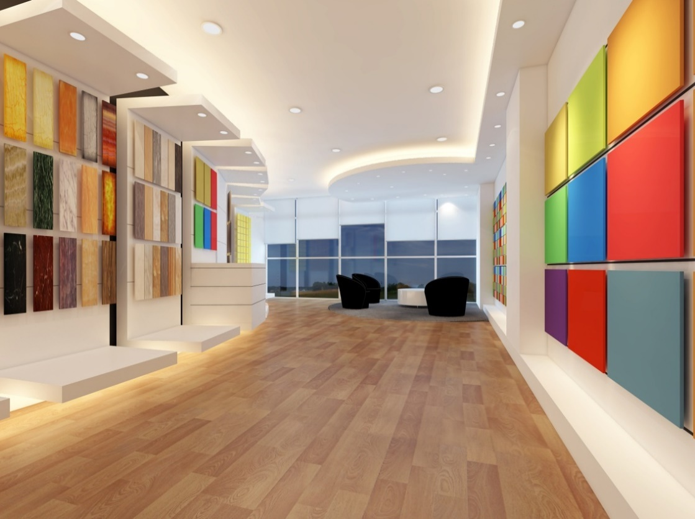
Completed Projects - ICA Pidilite - Experience Center
PROCESS FLOW:
Company – JV partner key achievements.
Products.
View company video.
Interact with the app / software.
Formal meeting area.

Slide 16
Ica Pidilite : Experience center to showcase product range.

Slide 17
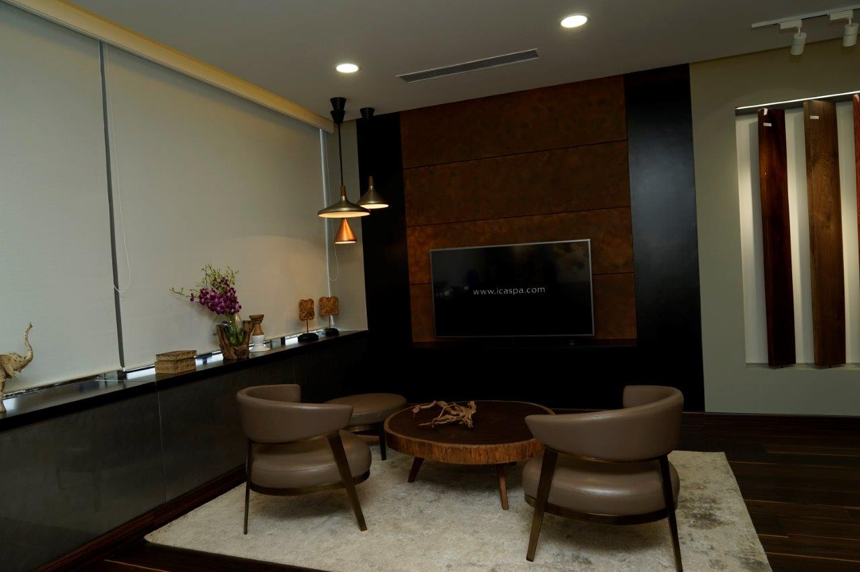
Ica Pidilite : Customer Connect Area.

Slide 18
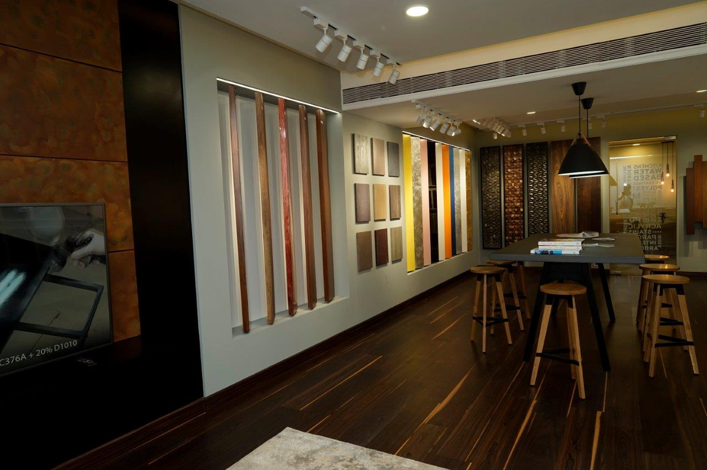
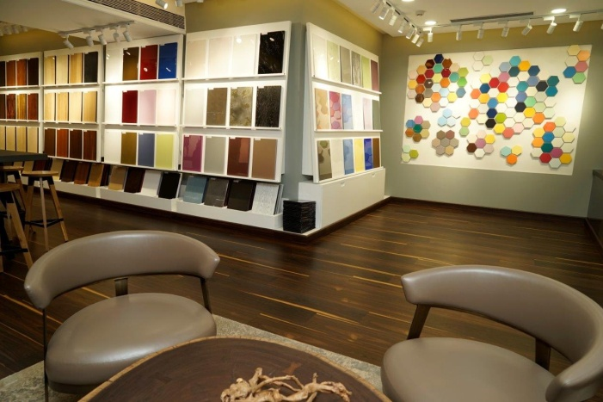
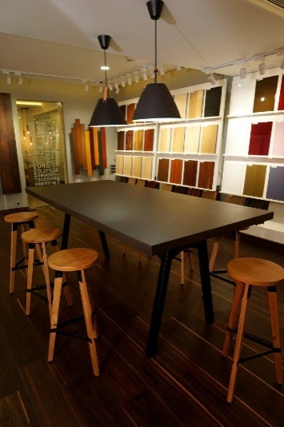
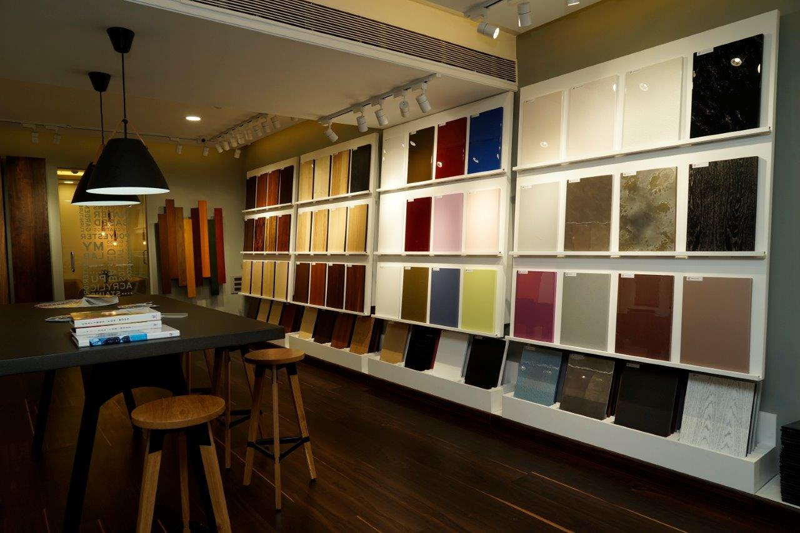
Ica Pidilite: Experience center to showcase product range.

Slide 19
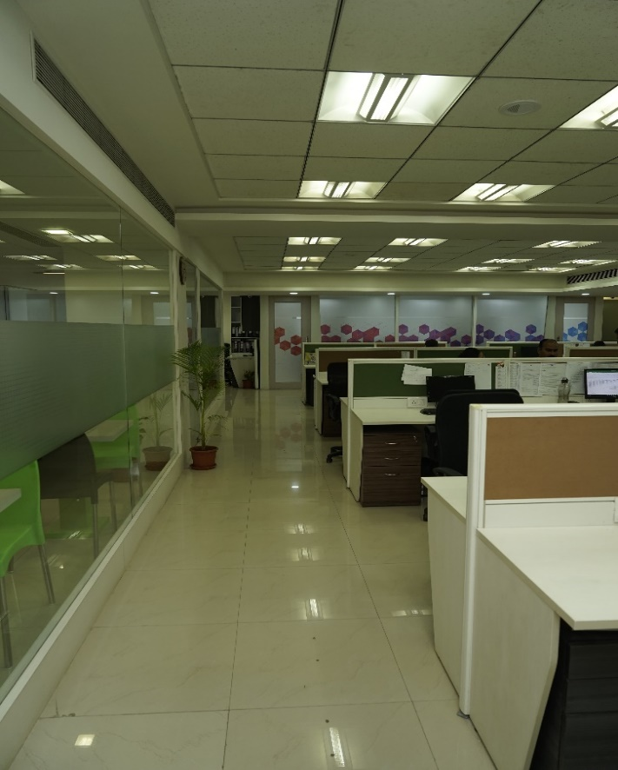
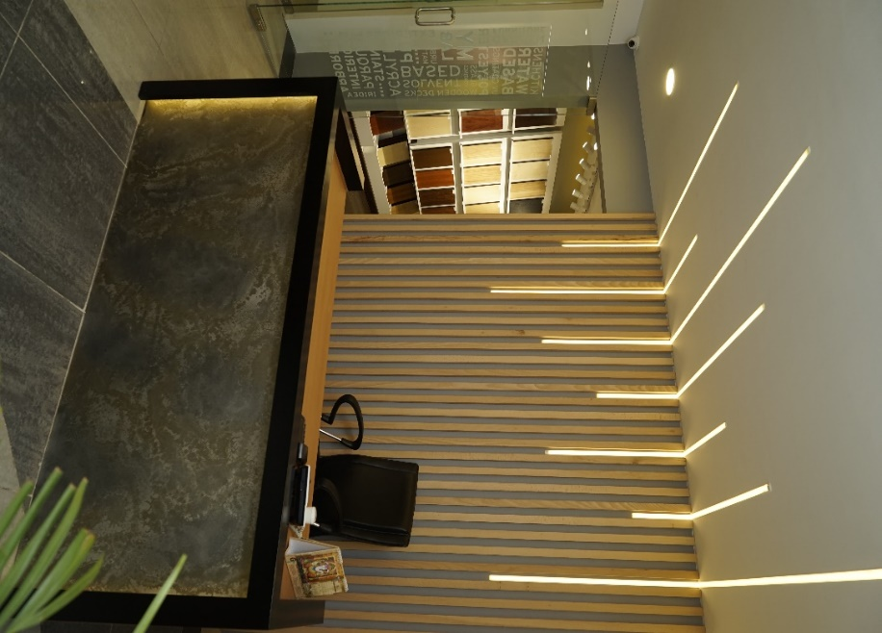
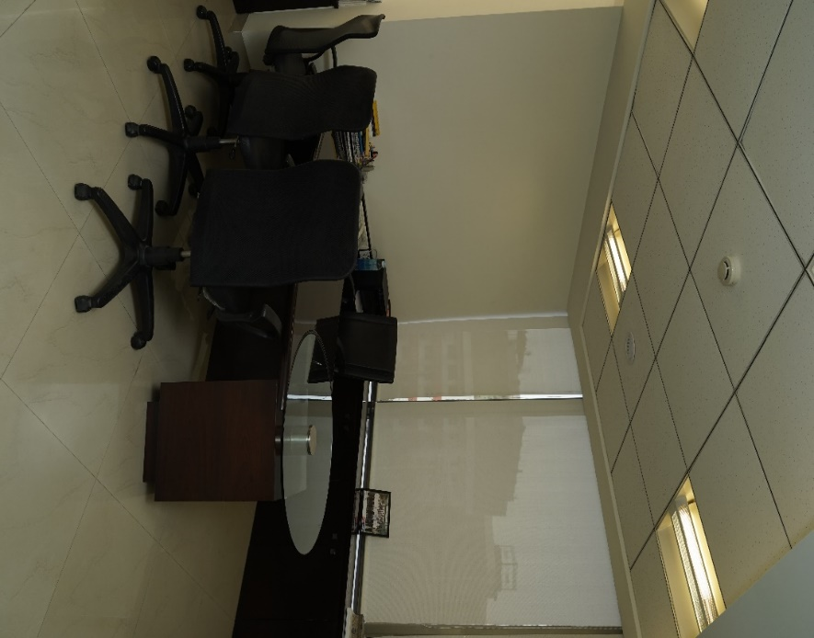
Ica Pidilite :- Head Office - 5500 sq.ft.

Slide 20
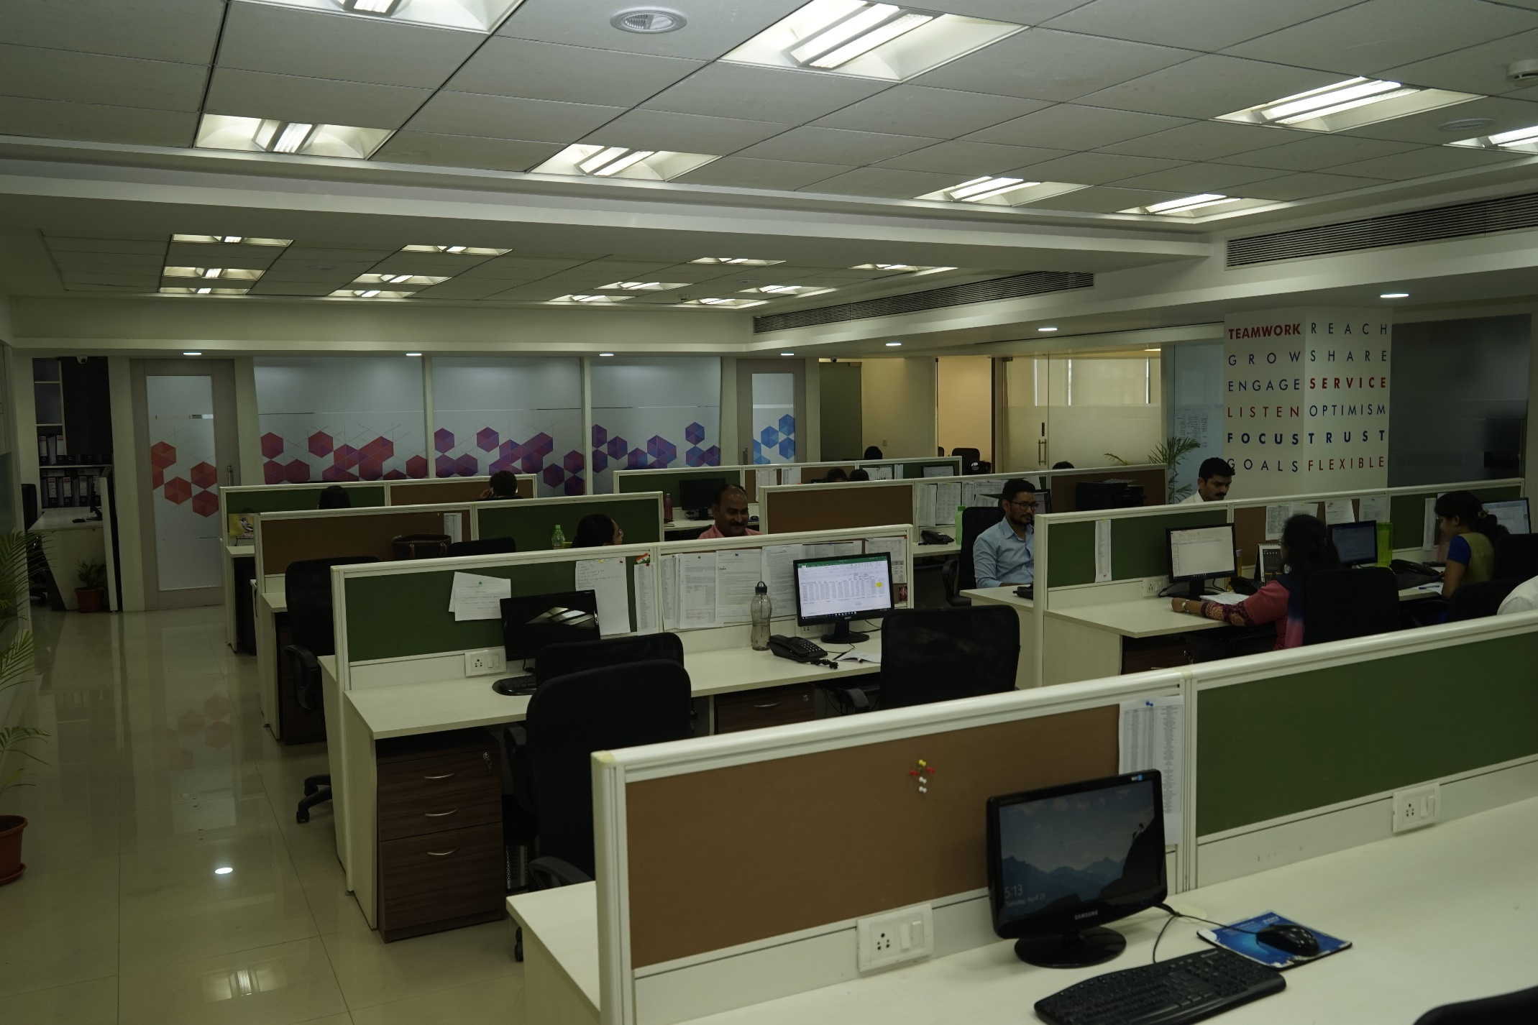
Ica Pidilite:- Head Office - 5500 sq.ft.

Slide 21
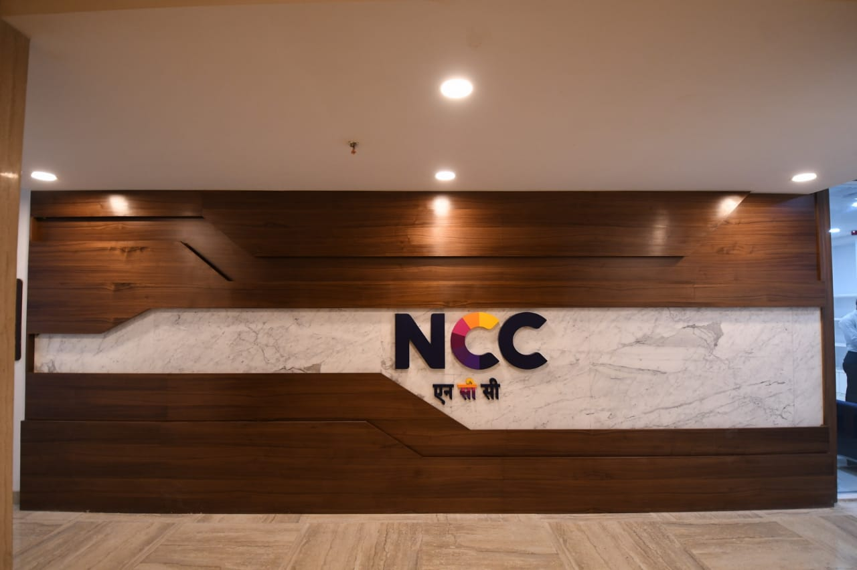
NCC- kalayojan Regional head office (3200 sqft)

Slide 22
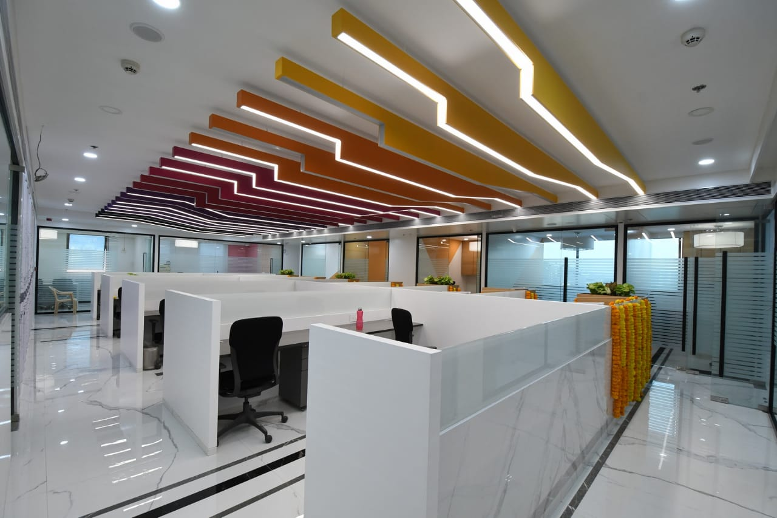
NCC- kalayojan Main office

Slide 23
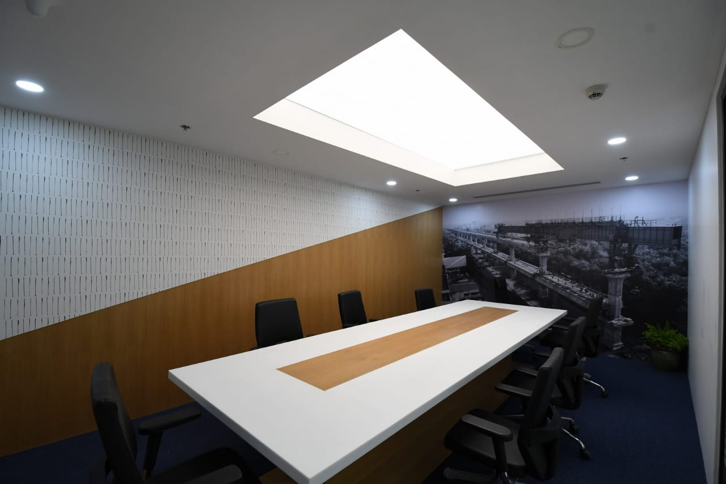
NCC- kalayojan Conference room

Slide 24
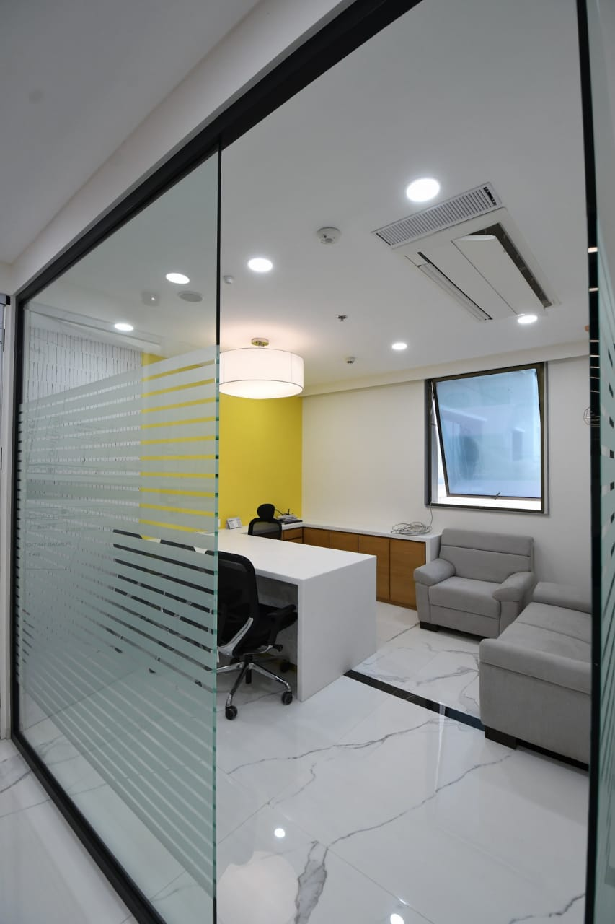
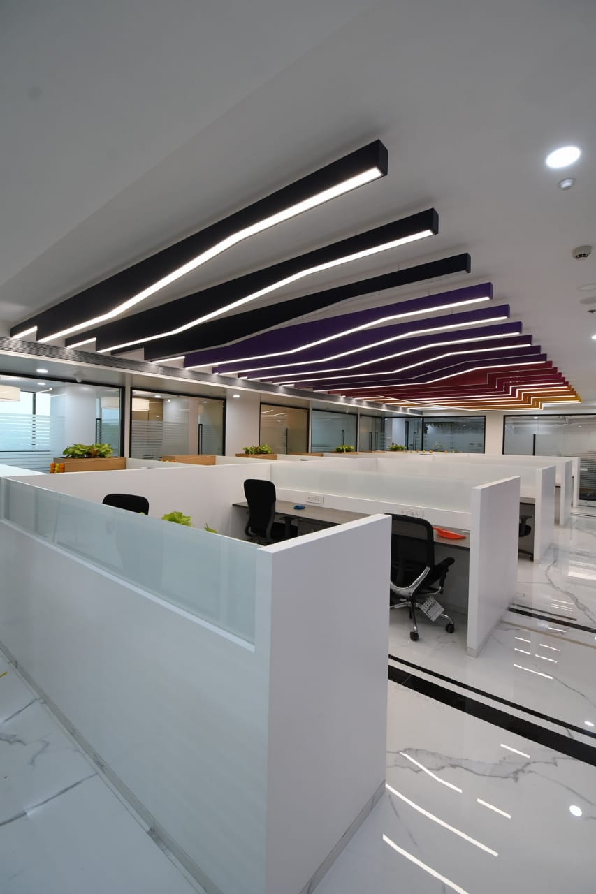
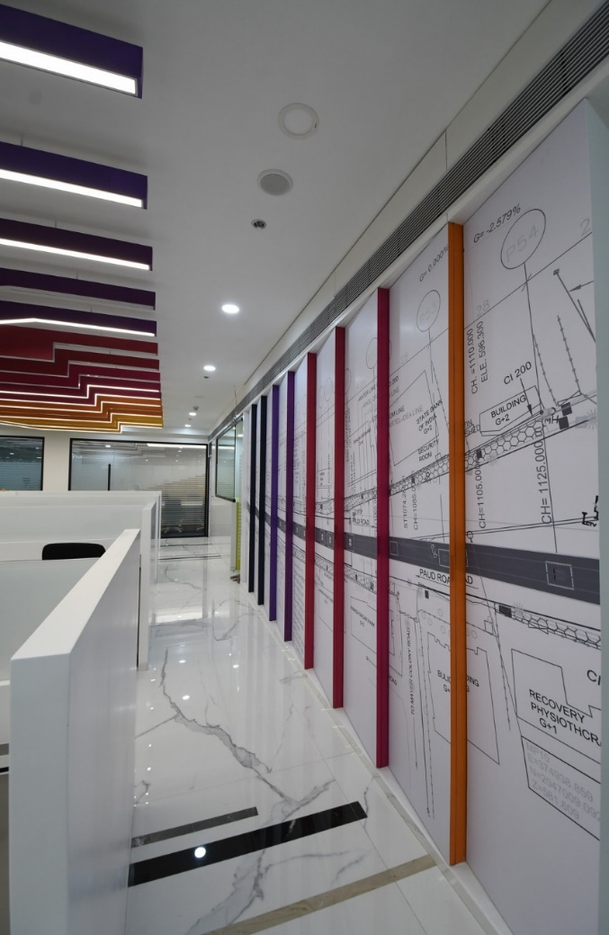
NCC- kalayojan Exe Cabin and other areas

Slide 25
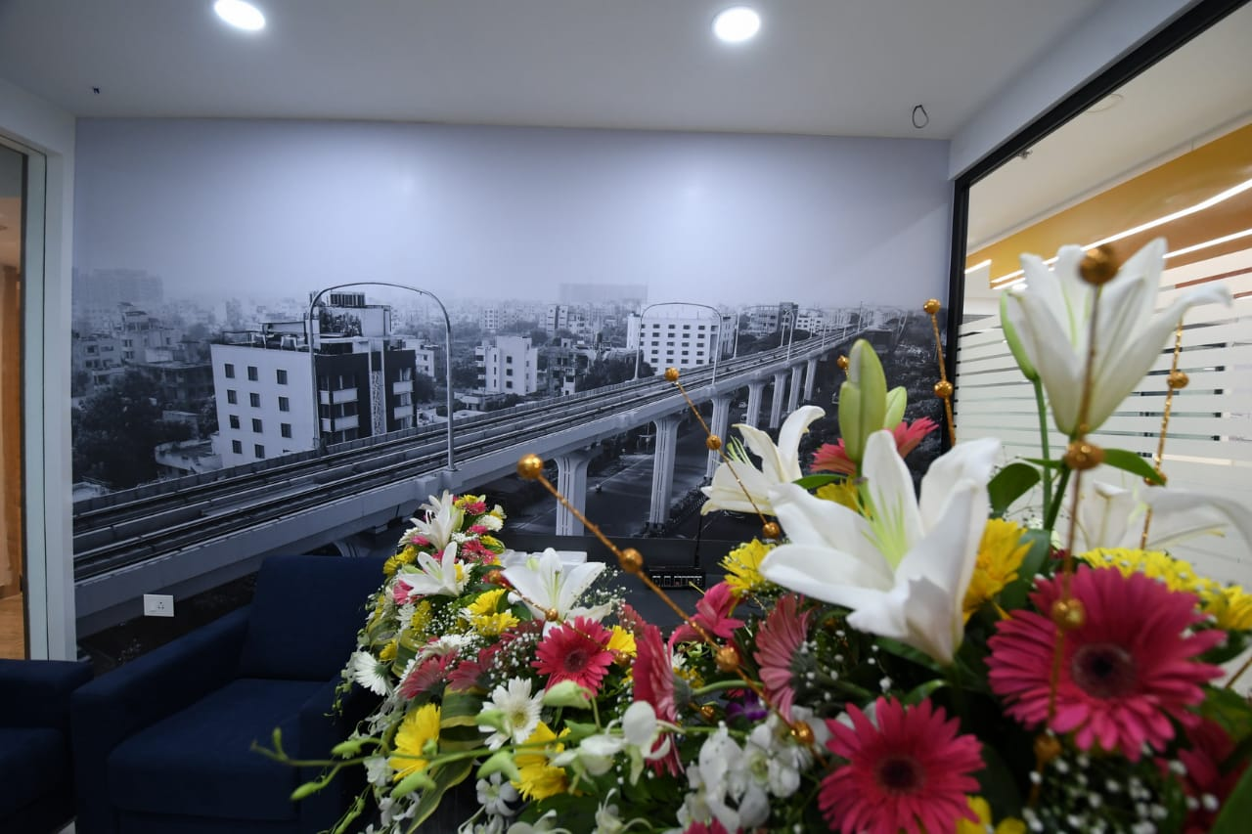
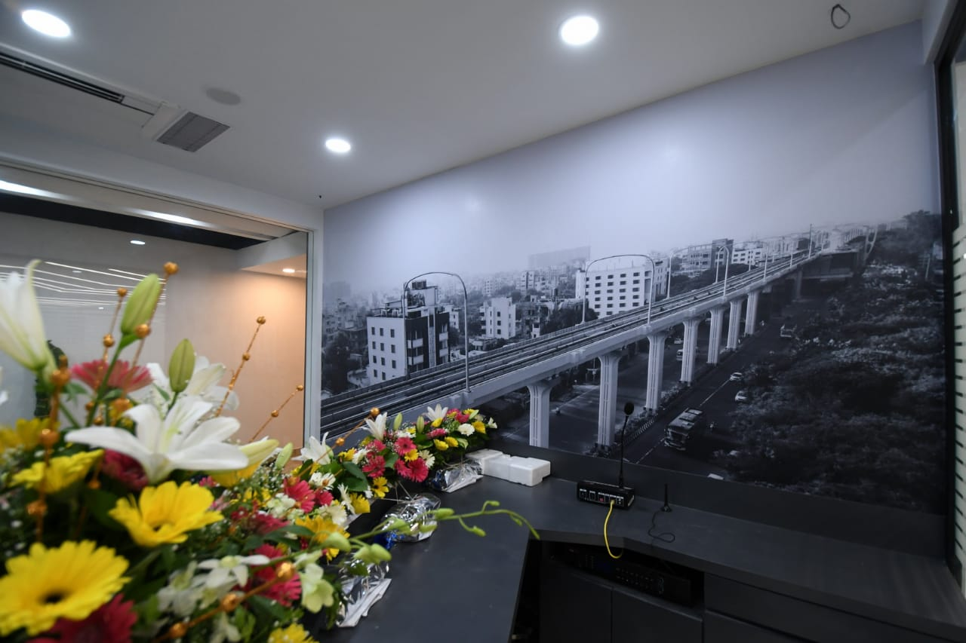
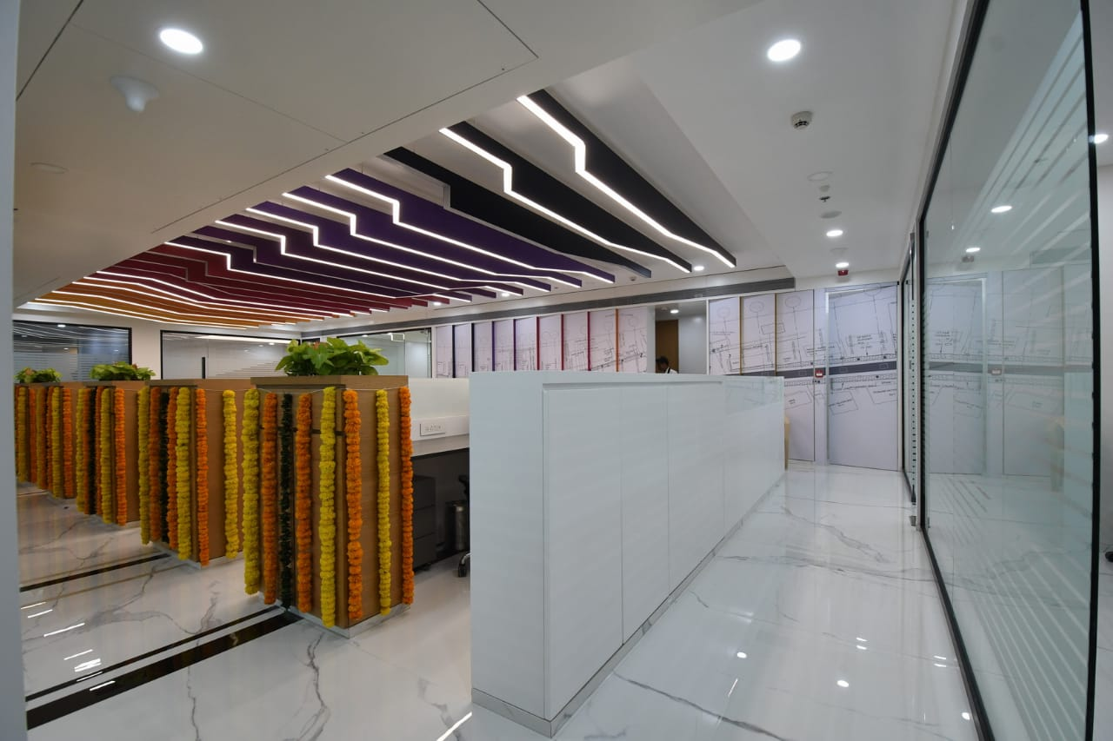
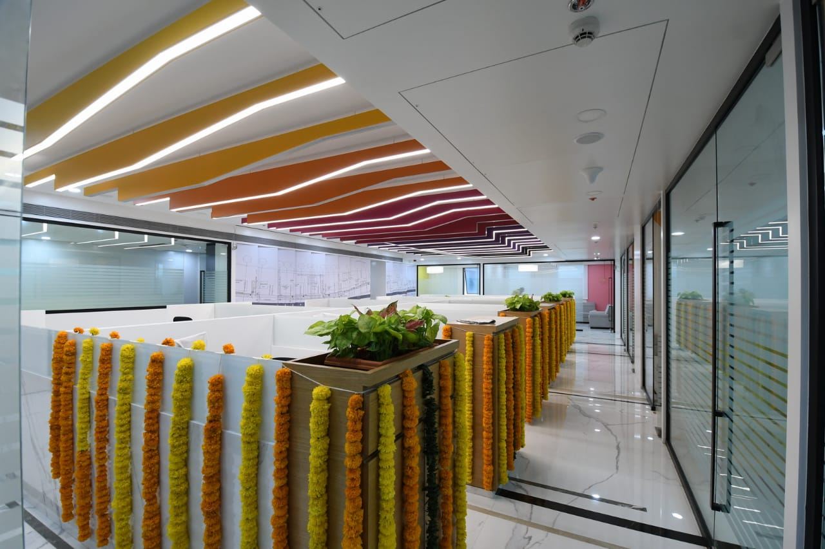
NCC- kalayojan Reception

Slide 26
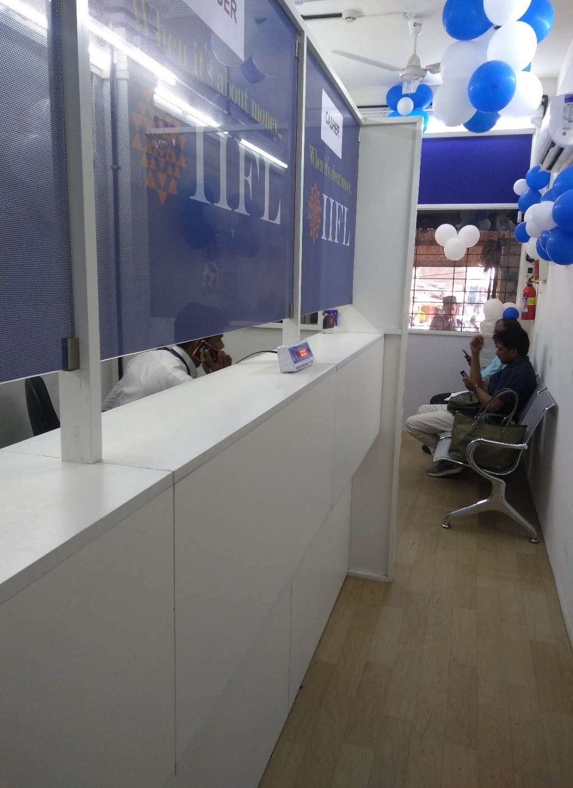
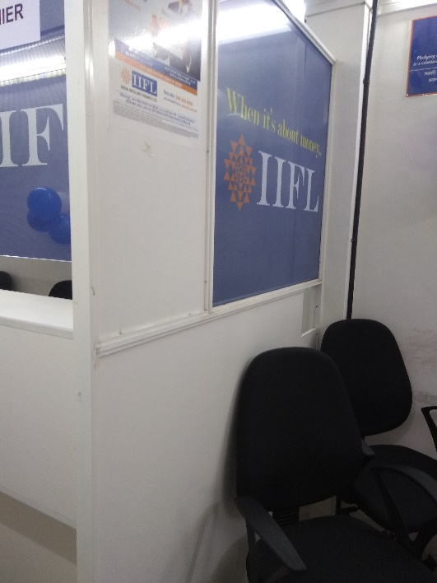
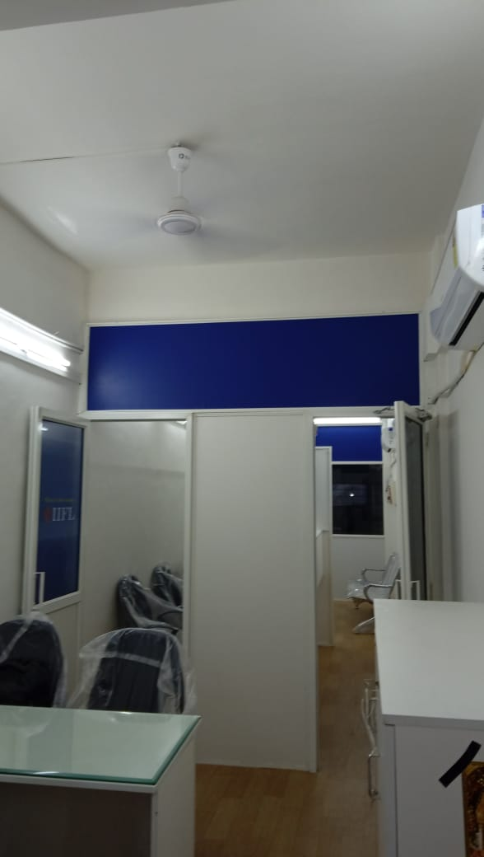
IIFL – Multiple offices across Maharashtra and Goa
( Valpoi, Nippani, Ulhasnagar, Neral, Udgir,Solapur, Latur etc.)

Slide 27

MARSH- Head office Mumbai 3000sqft

Slide 28

MARSH- Bangalore

Slide 29




PROJECT IN PROGRESS - MANOJA STHAPATYA,PUNE.

Slide 30




PROJECT IN PROGRESS

Slide 31

VLCC

Slide 32
RESIDENTIAL INTERIORS

Slide 33


Runwal Elegante – 4 Bhk at Andheri West

Slide 34




Runwal Elegante – 4 Bhk at Andheri West

Slide 35

Runwal Elegante – 4 Bhk at Andheri West

Slide 36





Runwal Elegante – 4 Bhk at Andheri West

Slide 37





Runwal Elegante – 4 Bhk at Andheri West

Slide 38





Runwal Elegante – 4 Bhk at Andheri West

Slide 39

Lodha Eternis – 2 Bhk at Andheri east

Slide 40


Lodha Eternis– 2 Bhk at Andheri east

Slide 41




Slide 42

Raheja Vihar– 3 Bhk at Chandivali, Powai,

Slide 43




Raheja Vihar– 3 Bhk at Chandivali, Powai,

Slide 44




Raheja Vihar– 3 Bhk at Chandivali, Powai,

Slide 45

Ekta Tripolis – 2 Bhk at Goregaon West

Slide 46




Ekta Tripolis – 2 Bhk at Goregaon West

Slide 47




Ekta Tripolis – 2 Bhk at Goregaon West

Slide 48

Meghdhoot – 3 Bhk at Andheri west

Slide 49






Slide 50


Slide 51


Makeovers– Reuse and Refurbish

Slide 52

Farmhouses- next to Vaitarna lake

Slide 53

Contact us
Direction One Elements
Tel no : +919820503710.
Email id : directiononeelements@gmail.com
Check us out on Facebook

